Slide 1

Predicting House Prices
Jack Olson

Slide 2
Summary
Model v2: Improving accuracy with Feature Engineering
Future model improvements
Model V1: Linear Regression with four features

Slide 3
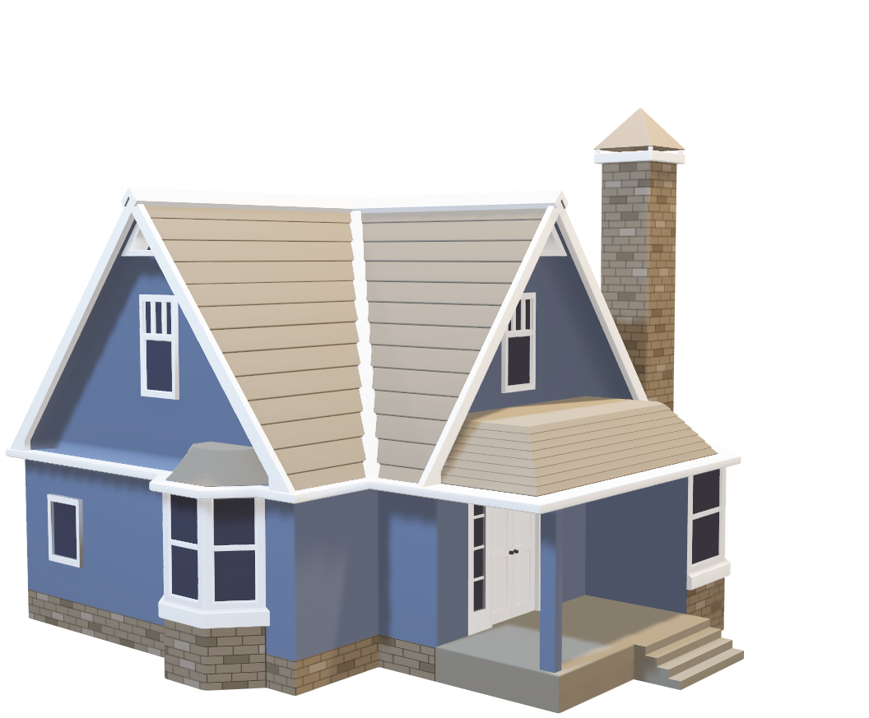
Part 1: Model Version 1

Slide 4
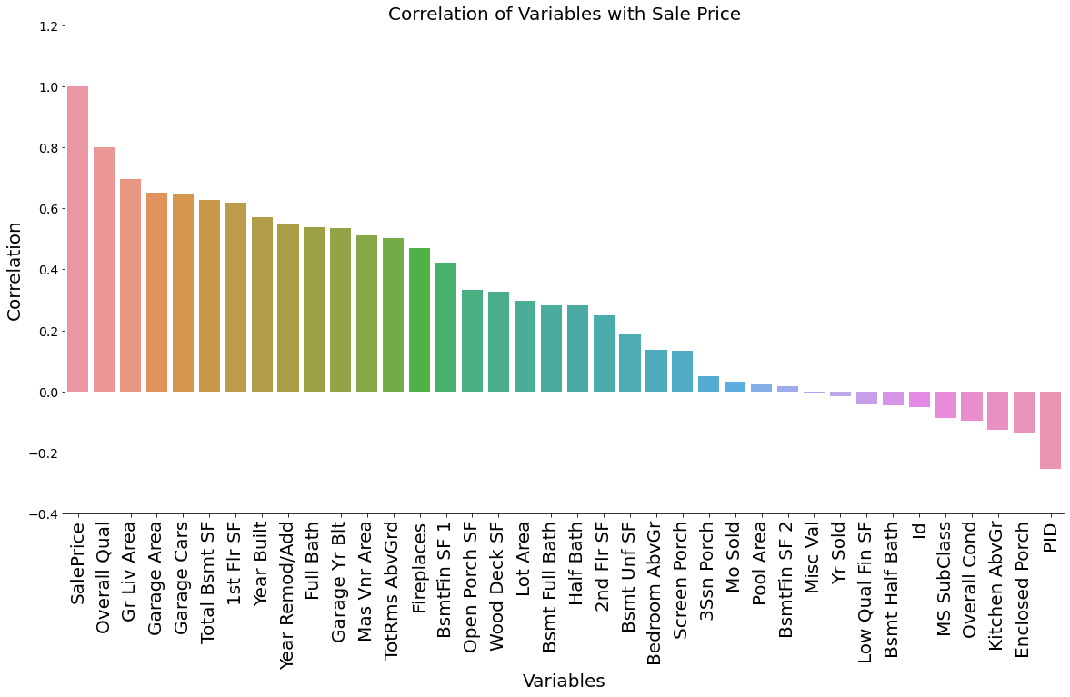





Slide 5
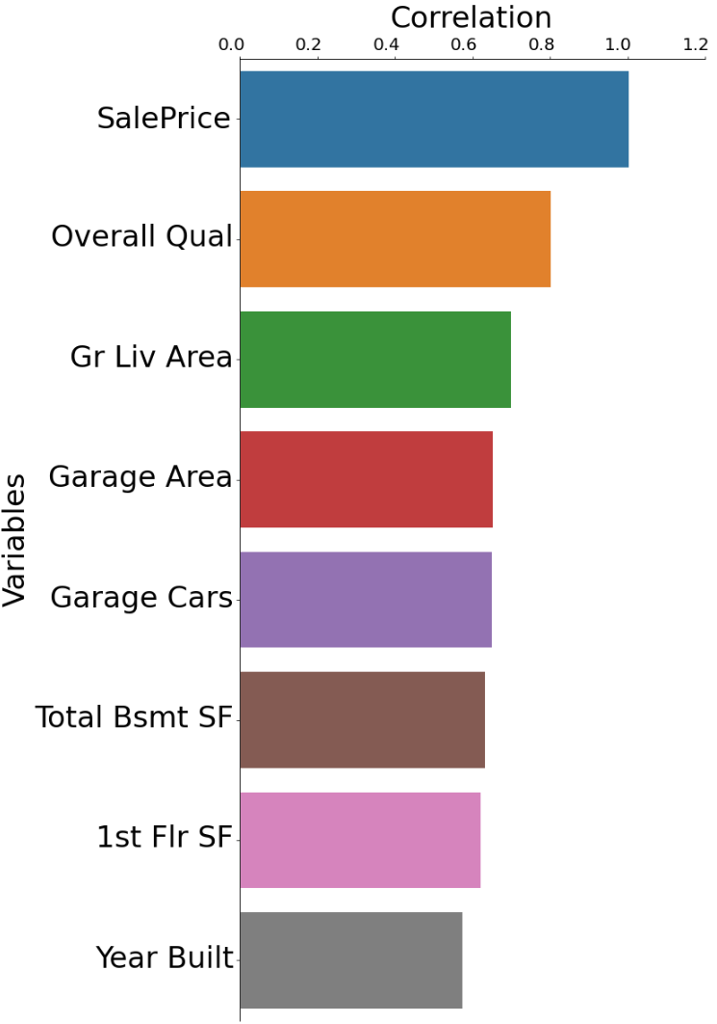




Features Selected
The three that were excluded are highly correlated with features already selected
Multicollinearity is a problem because it weakens the statistical power of the model

Slide 6
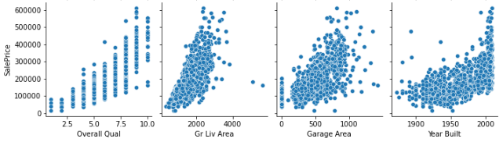
Year Built could be separated into three buckets:
1900-1950: Little correlation to price
1950-2000: Positive Correlation
2000-present: Little correlation
For a linear model it’s best if our features have a linear relationship with price

Slide 7
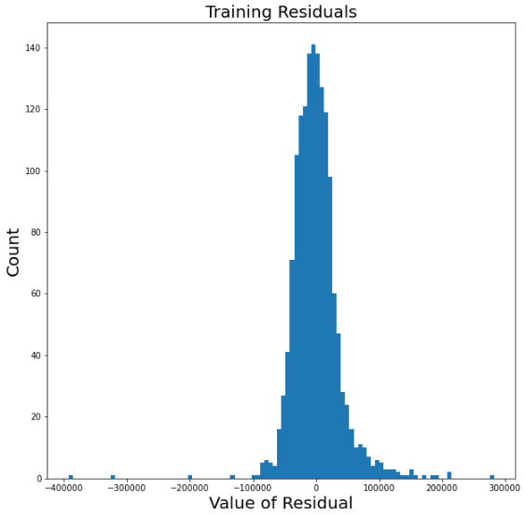

Model v1 Scores
181485
Training Data Mean Sale Price: $181,485
Residuals Approximately Normal
Slightly Overfit
Mean Squared Error: About $43,000, or 24% of the mean sale price

Slide 8
Model v1 Summary
Successes
Areas for Improvement
Easy to understand (only four features, simple linear regression)
Little correlation between features
Accuracy Could be Improved

Slide 9

Part 2: Model Version 2

Slide 10
Model v2 = Model v1 + Polynomial Features
Model v1
Polynomial Features
Model v2

Slide 11
What are Polynomial Features?
Size
Low Condition, Small Size
Low Condition, Large Size
High Condition, Small Size
High Condition, High Size
Polynomial Features increases accuracy by considering the interactions between features
Model v2 applies polynomial features to the same four features used in Model v1
Condition

Slide 12
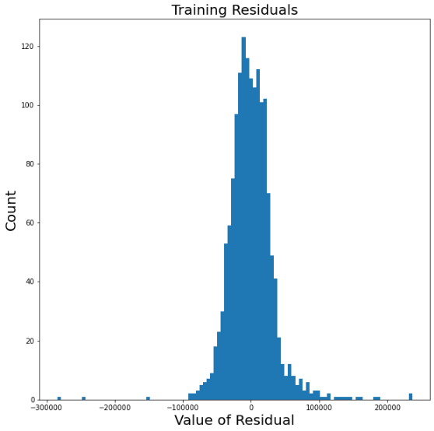
Model v2 Results
181485
Mean Squared Error: About $35,500, or 20% of the mean sale price
MSE improved by about $8000 compared to Model v1

Slide 13
Model v2 Summary
Retains the Successes of Model v1
Improves on Model v1
Easy to understand (only four features, simple linear regression)
Little correlation between features
Improved MSE from ~$43,500 to ~$35,500

Slide 14

Part 3: Future Model Improvements

Slide 15
Future Model Improvements
Ways to improve model accuracy
Possible Downsides
Use more features
Use Ridge, Lasso, or ElasticNet
Increased complexity, risk adding in “noise”
Mathematical complexity, harder to interpret coefficients

Slide 16
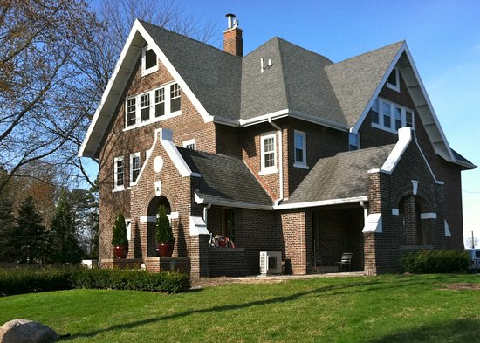
Conclusion
Model v1:
Linear regression with four features
Easy to interpret
Lower accuracy
Model v2:
Uses polynomial features to improve upon Model v1
Retains advantages of Model v1
Possible Future Improvements
Use more features
Use more mathematically complex methods

